Slide 1
Teamwork and Team Building

Slide 2
Trust Building through Effective Communication
Giving Feedback Across Cultures
Trust Building through Effective Communication
Encouraging Team Communication and Collaboration
Being an Effective Team Member
The Essentials of Managing Remotely
Take Care of your Health

Slide 3
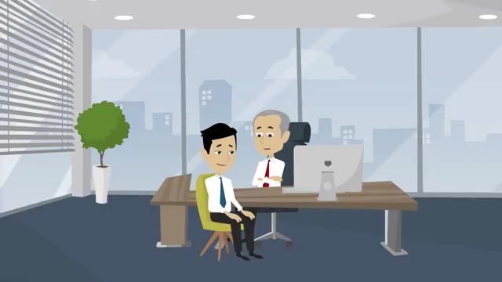
Giving Feedback Across Cultures
Introduction: Problems arise due to different cultural expectations and styles of communication.
2. Feedback in a Performance Review: Mark, a senior expat manager from the U.S. on one of his visits to the Indonesian office, gives feedback to Ahmad, a local sales representative who was originally employed by a traditional Indonesian firm.
Commitment for policy issues and current affairs

Slide 4
Giving Feedback Across Cultures
Two days later, Ahmad spoke to his local boss about whether he should move to another division. What might have caused him to think he should move?
Brief Analysis:
Since Mark is more senior in the organization and visits the local region only periodically, he and Ahmad most likely don’t have a strong relationship. And since Ahmad is from a culture where respect for hierarchy and the notion of saving face are paramount, there is a good chance he will take Mark’s critical feedback as a personal loss of face, even though Mark tries to couch the feedback between positive statements about Ahmad.
Ideally, feedback of this nature would come through Ahmad's local manager, where a stronger relationship and a common cultural understanding would help ameliorate the critical input. It's also possible that his manager might give this input to Ahmad during an informal chat over coffee or some place out of the office.
Commitment for policy issues and current affairs

Slide 5
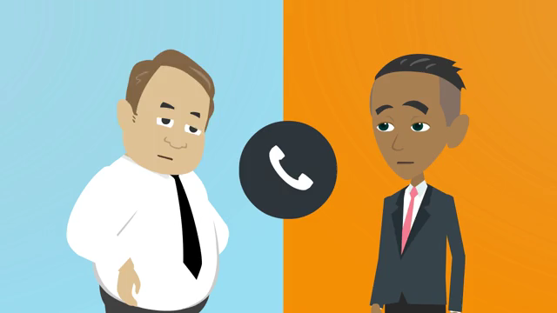
Giving Feedback Across Cultures
Feedback on a Project Team
Commitment for policy issues and current affairs

Slide 6
Giving Feedback Across Cultures
What’s going on in the previous slide? Reflect for a moment on what signals may have been missed
Brief Analysis
Critical or negative feedback can be handled in two ways: You can say something negative or you can conspicuously not say anything positive. In cultures that place a premium on saving face and avoiding confrontation, the latter approach is often preferred.
While Mohamed's tone may have sounded positive, we need to dig deeper to hear what's not being said. Mohamed has several chances to say something positive about Karl's solution, but he never does. Karl continues to press Mohamed to give him some explicit verbal feedback on his idea. This is difficult for Mohamed who has been trying to communicate indirectly what he thinks of Karl's idea. He finally replies, "Would you like us to try that?" even though he knows that of course Karl wants them to try it.
Since Karl thinks critical feedback can only take the form of saying something negative, and he doesn’t hear anything specifically negative, he assumes Mohamed and his team like his idea. If Karl wants to work productively across cultures, he should be looking for the absence of anything positive, not just the presence of something negative.
Commitment for policy issues and current affairs

Slide 7
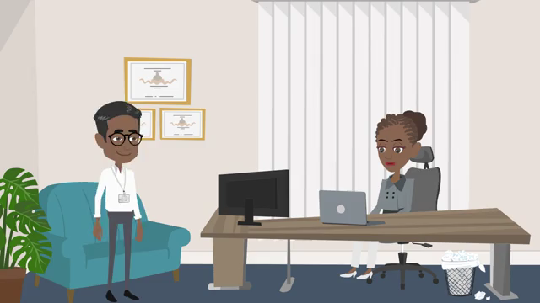
Giving Feedback Across Cultures
Seeking Input on a Candidate: Sarah, an American manager, asks for input from Azim, an Indian colleague
Commitment for policy issues and current affairs

Slide 8
Giving Feedback Across Cultures
What’s going on in the previous slide? Reflect for a moment on what signals may have been missed
Brief Analysis
As discussed in the previous scenes, when working with people from cultures where indirect communication is the norm, it’s crucial to look for what’s left unsaid as much as what is said.
Note that in response to Sarah’s preference for the candidate Ravi, Azim hesitates slightly, and then mentions that his boss had a question regarding Ravi’s level of experience. Sarah replies that she feels that was not an issue, and moves on, but Azim is silent. Sarah continues to press, asking Azim for any other verbal feedback before making a decision.
Azim then says “Yes, we also think it is best if we have the right person,” (trying to remind Sarah that having the "right" person is what's key here) and ending by saying he needs to see what else his boss might have to say, thereby implying that more time is needed before this decision is made.
Unfortunately, Azim’s indirect style is probably too subtle for Sarah, and she most likely comes away from this encounter assuming that Azim agrees that Ravi is the best candidate.
Commitment for policy issues and current affairs

Slide 9
Giving Feedback Across Cultures
Different Feedback Styles
In many parts of the world, especially in much of Asia and the Middle East, maintaining social stability through harmonious relationships is crucial, and has been for centuries. Because of this, people from these parts of the world have developed ways to give input that does not necessarily involve giving direct feedback to one another.
Several Meanings of "Yes“
Courtesy and Good Manners
“Yes” = I don't agree with you, but I don’t want to be the bearer of bad news because developing a relationship with you is important to me. So I’m telling you what it seems that you want to hear.
I also assume you know this, and therefore if I show some hesitation, you will check with others to find out more, or you will ask me again, perhaps in a different setting, to find out what I really think.
Commitment for policy issues and current affairs

Slide 10
Giving Feedback Across Cultures
Several Meanings of "Yes“
Respect for Hierarchy:
“Yes” = I don't agree with you, but you are the boss, so I don't want to overtly contradict you, and perhaps you indeed know what's best. I may try to express my initial disagreement in an indirect manner, but will probably wait to see if your answer is the right answer after all.
Need to maintain Harmony:
“Yes” = I don't agree with you but it's important for me to maintain harmony and avoid direct disagreement if at all possible, so I can only tell you my true opinion in an indirect way.
You will, however, be able to understand what I'm saying if you listen carefully to my explanation and ask questions about what I'm not saying. And if you want to know even more, you might consider asking me some of these questions in an informal setting outside of the office.
Commitment for policy issues and current affairs

Slide 11
Trust Building through Effective Communication
Being Clear about your intention: Clarity, Persuasion, Facts, Primary intent.
Know the Audience: Roles and Responsibility, differing working styles (task master, relationship builder), passive and sensitive, empathy, focus on learning rather than winning.
Leverage Relationship history when you communicate: History, background, past experiences.
The Unspoken Words :Body Language and Tone of Voice.: Smiling, keeping direct eye contact, pleasant listening level, friendly tone, what we don’t say is just as important as we do.
Manage your Emotions in Tough Situation: Emotional Intelligence, Self Awareness, Step Away from the issue.
It’s about you: Be Aware of Other’s Emotions: It start with you, your reaction, empathy, seeing things from other’s perspective, accommodate other’s emotions, builds trust.
Take Care of your Health

Slide 12
Encouraging Team Communication and Collaboration
Qualities of Good Communication: Direct and Honest, clear and understandable, two way street, team communication should be encouraging, value each contribution.
2. Handling Team overcriticism and overthink: Some criticism is good as it encourages ideas, overcriticism shuts down ideas before they a chance, focus on solutions, trap of groupthink, leaders can play the devil’s advocate, balance between overcriticism and groupthink.
Correcting Imbalances in Team Participation: Interrupt the Interrupters, set ground
before start of Team Meetings, encourage the non contributor to speak, look for signs like body language amongst the non contributors.
4. Collaboration not Competition: Uncontrolled Competition is bad, too much collaboration is bad too, groupthink and not diverse ideas, ensure right mix of collaboration without allowing groupthink, assign tasks to groups rather than individuals, designate mentors,
Commitment for policy issues and current affairs
5. Achieving Collaboration through Team Oriented Messages: Individual Tasks are assigned to the Team Goals, Encourage Team Goals, acknowledge individual achievements in the context of Team Goals, fostering sharing and supporting.

Slide 13
Being an Effective Team Member
The Power of a Positive Attitude: Rather than going it alone or complaining about
team members, team should feel that they are in it together and all members count, listen to others and they will to you too, change your attitude towards the Team and theirs will change too.
2. Adopting a Positive Mindset: Look at others strength, focus on the benefits of working in the team, focus on the benefits of working in a Team, accept mistakes, learn from them, move on.
What being proactive is all about: Take the initiatives and get things done, energetic
and enthusiastic and energy spreads, proactive, think ahead, anticipate problems and think of Innovative solutions.
4. Acknowledging Different Opinions: Listening with open mind, don’t interrupt, use supporting statements even if you don’t agree.
5. Demonstrating respect: Use of non judgemental language, concentrate on the issues not person, use of “I” rather than “you”, give respect and you will get it back.

Slide 14
The Essentials of Managing Remotely
In this module, we'll explore strategies for setting up a virtual team, on-boarding new members, building trust, communicating effectively, helping isolated team members, and managing time zones.
What do you think are key elements of an effective remote team?
Set very Clear Expectations, track output not time, clearly define and communicate your team’s purpose, communicate through a variety of channels,
A high level of trust and rapport is crucial for an effective team. But this is challenging in a remote environment.
A high level of trust and rapport is crucial for an effective team. But this is challenging in a remote environment.

Slide 15
The Essentials of Managing Remotely
How to build Trust across a distance
Credibility is about content expertise and our “presence:” how we look, act, react, and talk about our content. For example: “I can trust what she says about intellectual property; she’s very credible on the subject.”
Reliability relates to our actions. It is about whether others think we are dependable and can be relied on to behave in consistent ways. For example: “If he says he’ll deliver the product tomorrow, I trust him, because he’s dependable
Connection is about the degree of safety and security one feels when asking someone to do something. For example: “I can trust her with that information; she’s never violated my confidentiality before, and she would never embarrass me
Self-Focus refers to the extent that we care about ourselves vs. caring for others. Is our focus primarily on ourselves, or on the person(s) with whom we are engaging? For example: “I don’t trust him. I think he’s too concerned about how he’s appearing, and he’s not really paying attention to what I'm saying

Slide 16
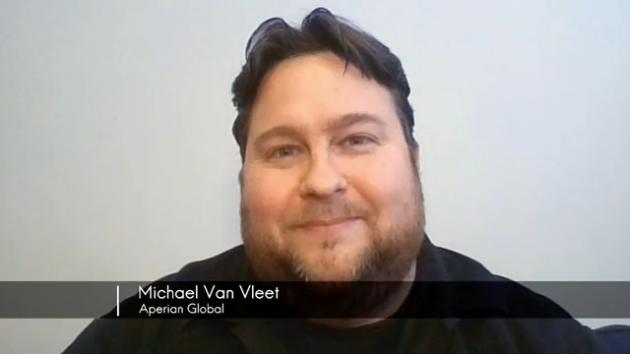
The Essentials of Managing Remotely
How to build Trust across a distance
Use cloud-based teamwork, team chat and video conferencing apps.

Slide 17
The Essentials of Managing Remotely
Onboarding Remote Team Members
Onboarding a new team member can be time consuming. There is new software to install, new protocols to teach, and a dizzying array of new guidelines, best practices, and logistics... not to mention getting to know new people.
Check in regularly with the new team member, set up a virtual meeting to introduce the new Team Member, Create self study items for the new team member,

Slide 18
Thank You!

